Slide 1
Computer Vision
First Meet – Introduction [Part 3]
ADF

Slide 2

Agenda
Part 1: Course Introduction, Course Preparations
Part 2: Brief history of Computer Vision
Part 3: Recognition and Detection
Computer Vision

Slide 3
Image Classification
Computer Vision

Slide 4





Image Classification
…
Train
Classifier
cat
Computer Vision

Slide 5
Computer Vision Core
Character Recognition
Identification
Image Classification
Object Localization
Content-based Image Retrieval
Objects Annotation
Objects Detection
Image Captioning
Instance Segmentation
Computer Vision

Slide 6
Recognition and Detection
Computer Vision

Slide 7
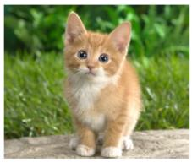
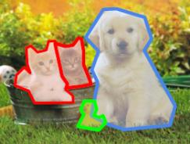

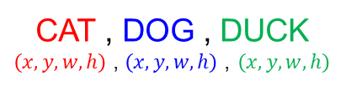
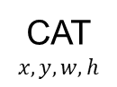
Computer Vision Tasks
Classification
+ Localization
Instance
Segmentation
Classification
Object Detection
CAT
CAT
$$x,y,w,h$$
CAT , DOG , DUCK
$\left(x,y,w,h\right)$ , $\left(x,y,w,h\right)$ , $\left(x,y,w,h\right)$
CAT, DOG, DUCK
Single Object
Multiple Objects
Computer Vision

Slide 8
Classification
Input : Image,
there may be an object inside
Output : Class Label
Single object per image
Evaluation metric:
Accuracy
Also called Recognition, Identification
CAT
Computer Vision

Slide 9
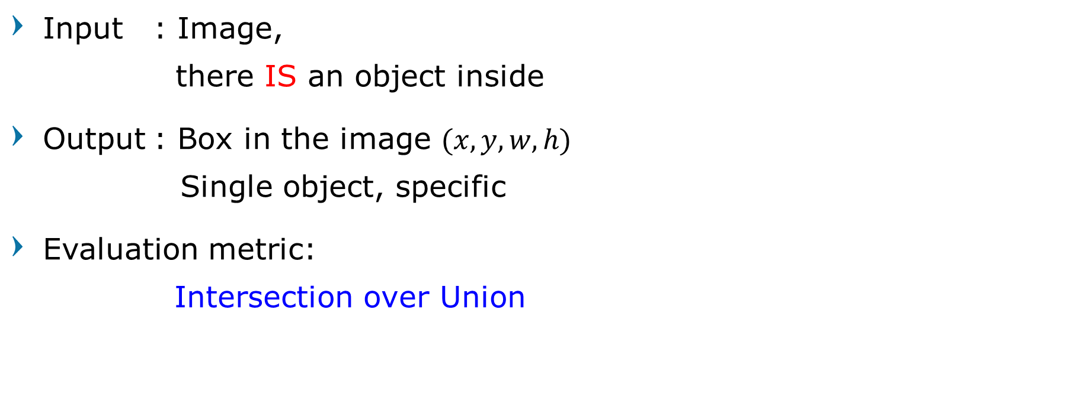
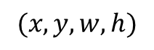
Localization
Input : Image,
there IS an object inside
Output : Box in the image $(x, y, w, h)$
Single object, specific
Evaluation metric:
Intersection over Union
$$(x, y, w, h)$$
Computer Vision

Slide 10
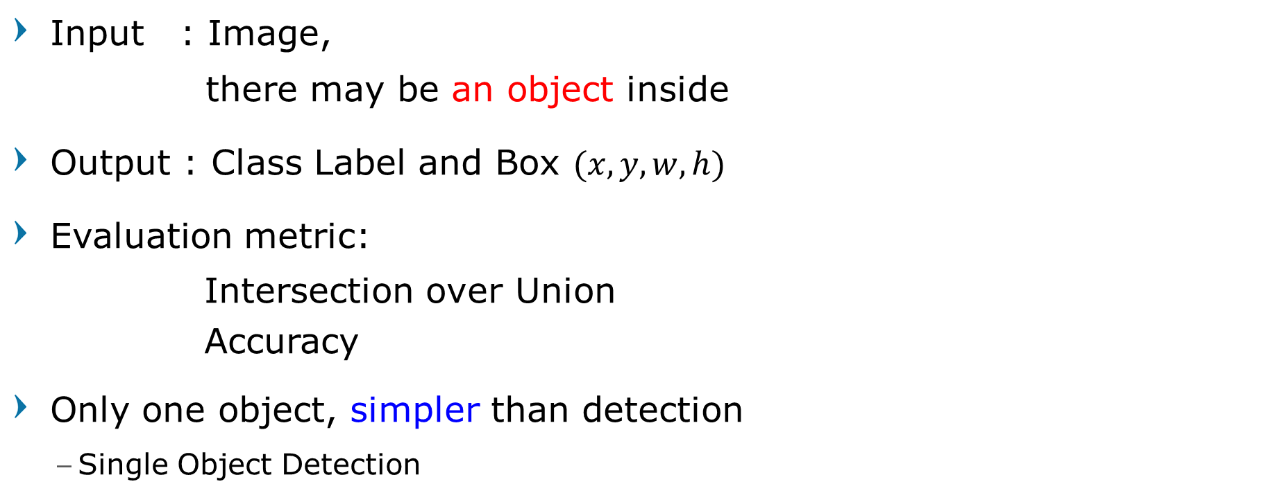
Classification + Localization
Input : Image,
there may be an object inside
Output : Class Label and Box $(x, y, w, h)$
Evaluation metric:
Intersection over Union
Accuracy
Only one object, simpler than detection
Single Object Detection
CAT
$$(x, y, w, h)$$
Computer Vision

Slide 11
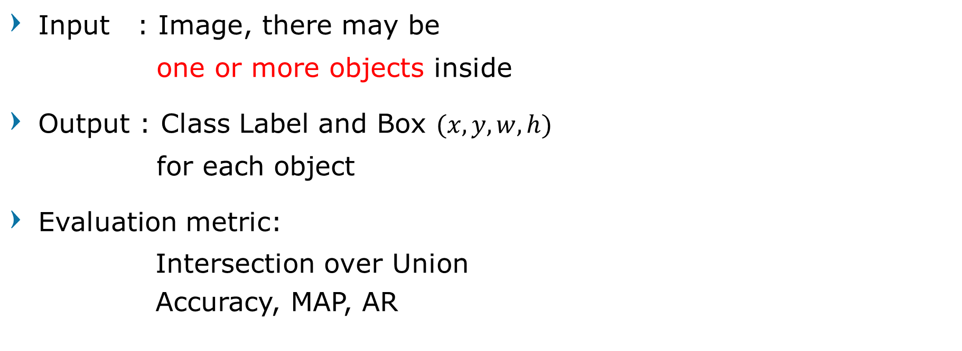
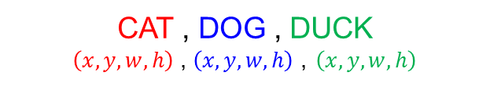
Object Detection
Input : Image, there may be
one or more objects inside
Output : Class Label and Box $(x, y, w, h)$
for each object
Evaluation metric:
Intersection over Union
Accuracy, MAP, AR
CAT , DOG , DUCK
$\left(x,y,w,h\right)$ , $\left(x,y,w,h\right)$ , $\left(x,y,w,h\right)$
Computer Vision

Slide 12

Semantic Segmentation
Input : Image, there may be
one or more objects inside
Output : Pixel label
Evaluation metric:
Intersection over Union
Jaccard Index, Dice,
Accuracy, MAP, AR
Computer Vision

Slide 13
Instance Segmentation
Input : Image, there may be
one or more objects inside
Output : Pixel label for each instance
Evaluation metric:
Intersection over Union
Jaccard Index, Dice,
Accuracy, MAP, AR
Computer Vision

Slide 14
Summing it up
Classification / Recognition : What is
Localization : Where is
Classification + Localization : What and where is
Object Detection : What and where are
Segmentation : Which label pixel is
Instance Segmentation : Which instance pixel is
Computer Vision

Slide 15
Discussion Time
Computer Vision

Slide 16
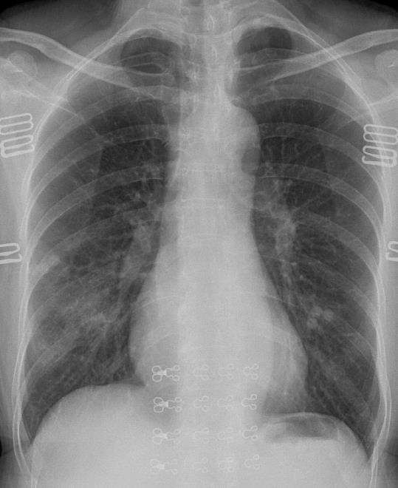
Classification or Detection?
Computer Vision

Slide 17

Classification or Detection?
Computer Vision

Slide 18
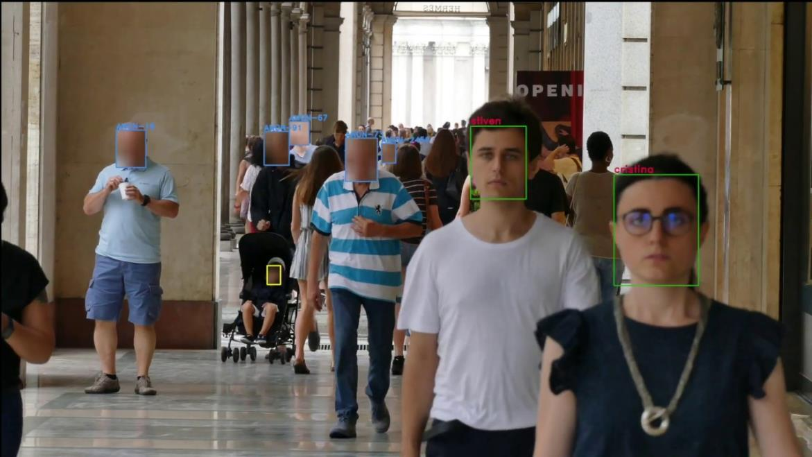
Classification or Detection?
Computer Vision

Slide 19

Identification: Recognition or Verification?
Computer Vision

Slide 20
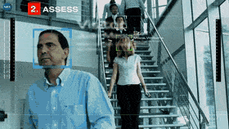
Video or Image input?
Computer Vision

Slide 21
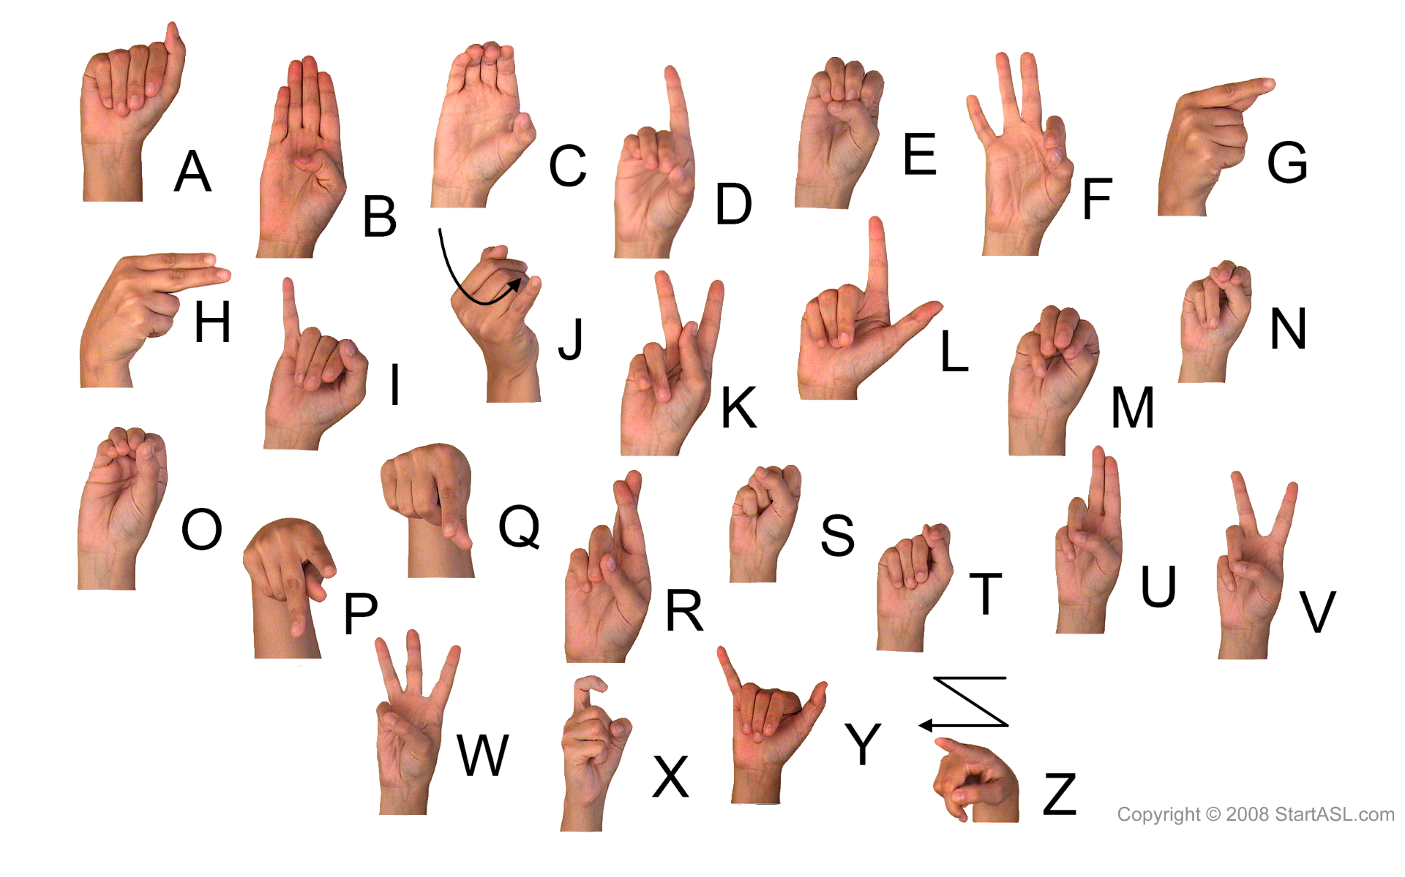
Video or Image input?
Computer Vision

Slide 22

Video or Image input?
Computer Vision

Slide 23
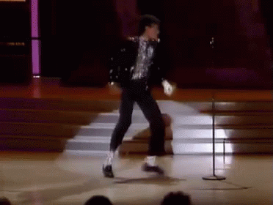
Video or Image input?
Computer Vision

Slide 24

Question?
Computer Vision

Slide 25

Next Agenda
Challenge in Computer Vision
Hyperparameter and Data Handling
Linear Classification
Computer Vision

Slide 26
References
Fei-Fei Li, Andrej K, Justin J - Stanford CS231n 2016 Course
Fei-Fei Li, Justin J, Serena Y - Stanford CS231n 2018 Course
Grauman, K. and Leibe, B. 2011. Visual Object Recognition. Synthesis Lectures Artif. Intell. Mach. Learn. 5, 1 181
Computer Vision

